Slide 1

Pittsburgh Crime
Data Storage & Retrieval
W205-4
Mona Iwamoto, Zach Ingbretsen, Richard Hitchens, Jason Salter
24 April 2017

Slide 2
Agenda
Investigation Topic
Ingesting Data
Storing Data
Serving Data

Slide 3
Use Case
Seeking to provide analytic insight to crime in Pittsburgh. User Interface to access multiple data sets for police departments and community organizers to better understand crime.
An example use case would be to use multi-day crime incident forecasts for determining Police Department personnel rostering optimization.

Slide 4
Pittsburgh - Combining Data
Multiple Datasets
Police
Incident blotter
Arrests
Officer training
Weather - forecasts/historical
Health
Poverty
Mapping data

Slide 5
Design Architecture
Course consistent architecture:
Ingestion
Layer
OpenWeatherMap API
Wunderground API
Data.gov API
Postgres Raw Data
Batch
Layer
Batch Processing / Dirty Data Cleaning
Serving
Layer
Postgres Clean Data
Analysis and Predictions
User
Interface
ESRI GIS
HTML via cherrypy
Jupyter Notebooks

Slide 6
Design Architecture
PostgreSQL chosen for proof of concept reflective of volume and velocity considerations for Pittsburgh standalone data, e.g. an average of 112 crime incidents per day for the crime blotter data updated daily. Other data sets also at most daily update.
Increased velocity and volume would come from scaling to more cities and new real-time data feeds.

Slide 7
Analysis and Customer Interface
Multinomial Naive Bayes machine learned crime incident predictions model
Features include: Chronologic anomalies, seasonality/weather and demographics
Advanced analytics using GIS interface for mapping and geospatial features
HTML for easy graphics and access
Custom dataset retrieval
Able to expand
Limited for project initial setup times

Slide 8
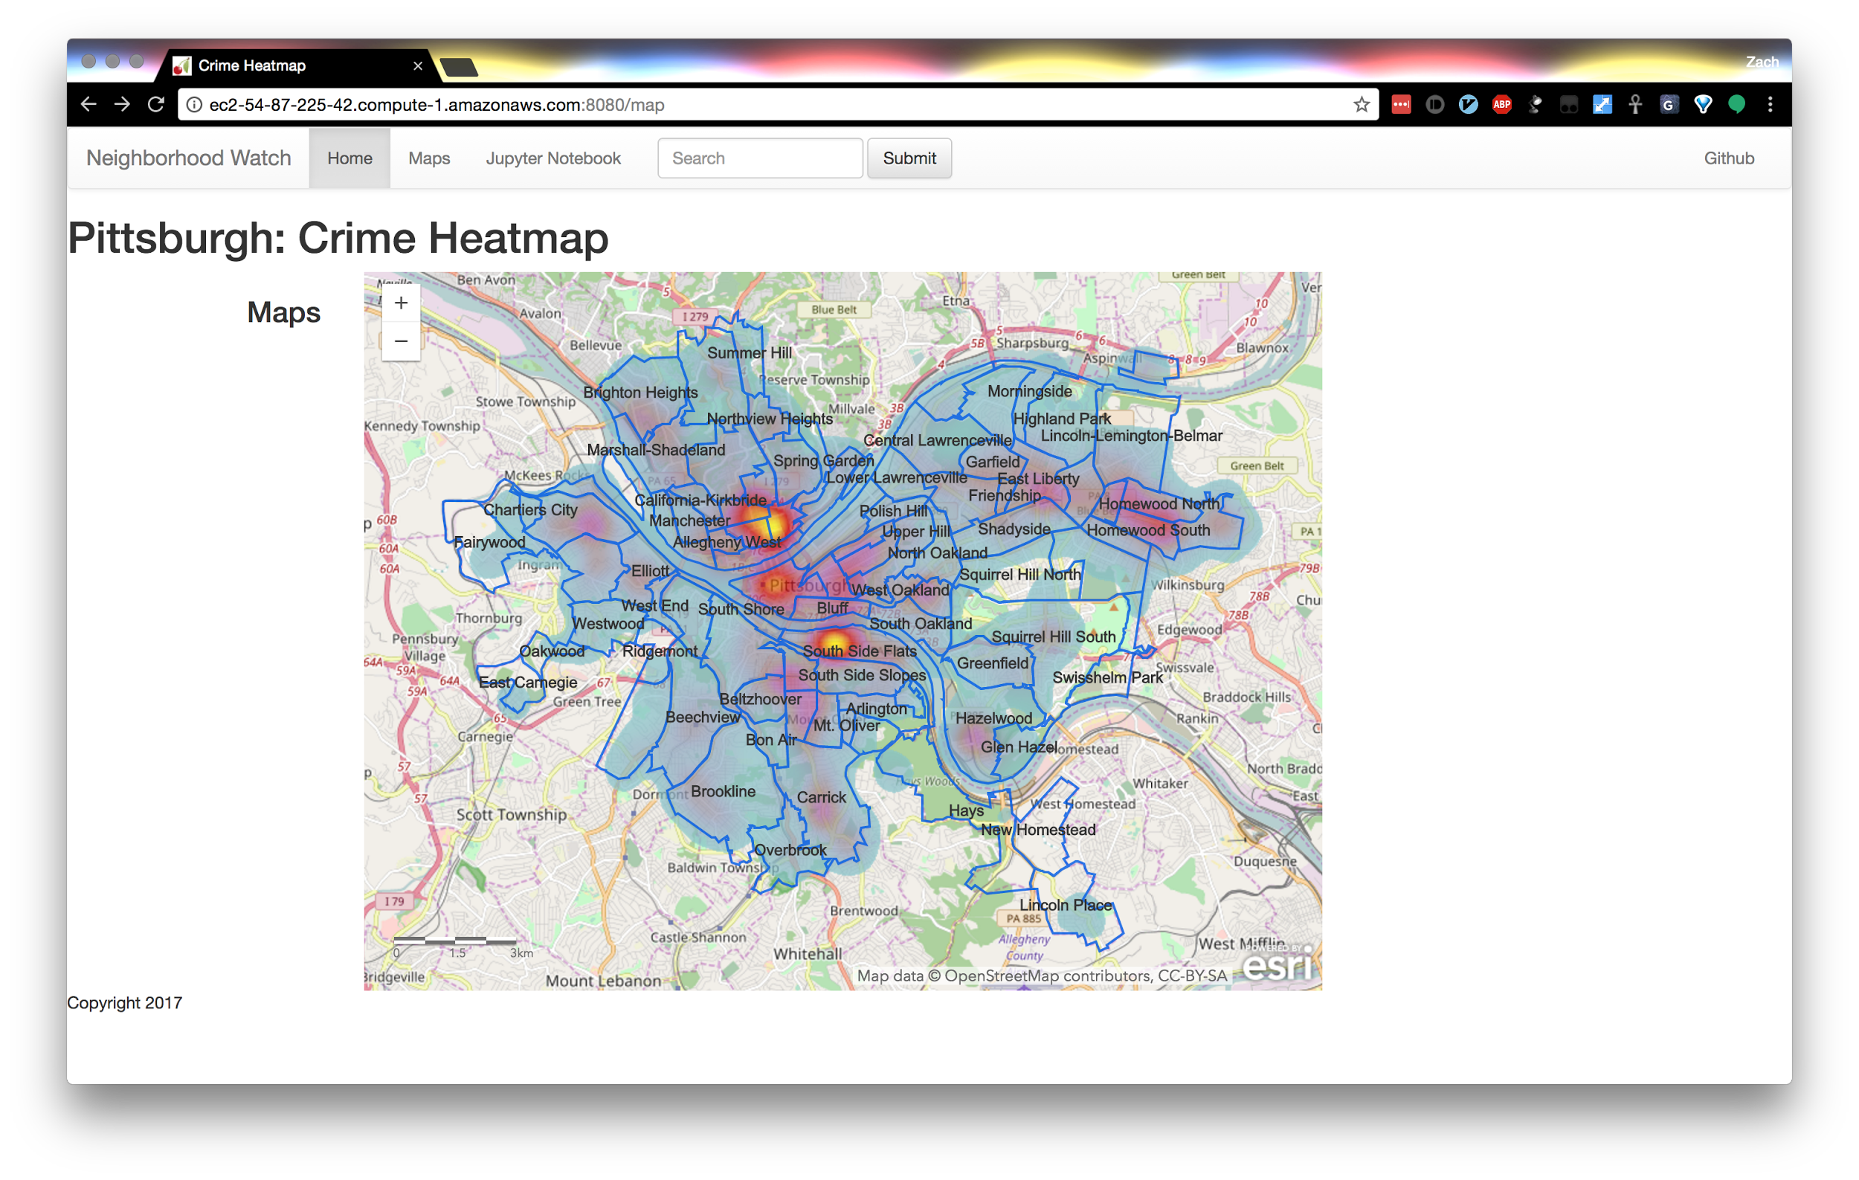
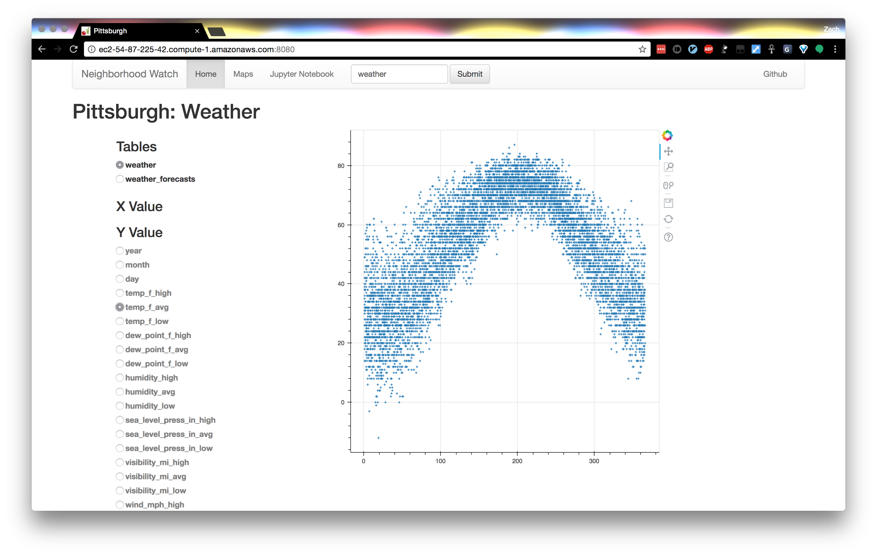
Analysis and Customer Interface

Slide 9
Scaling the Data
Expanding across the Nation
Multiple cities
Data availability
Formatting challenges
Parallel processing needed
Storm
Batch nature of data would off-load processing to low load times of day
Distributed data storage with HDFS
SparkSQL

Slide 10
Project Evolution
For geo-processing, it would have been interesting to look at response times for emergency personnel (distance/resource analysis).
More detailed machine learning analysis using more of the available data sets.
Comparison between cities.
A more professional front-end web interface.

Slide 11
Questions

